Slide 1
Chapter 2 Motion in One Dimension

Slide 2
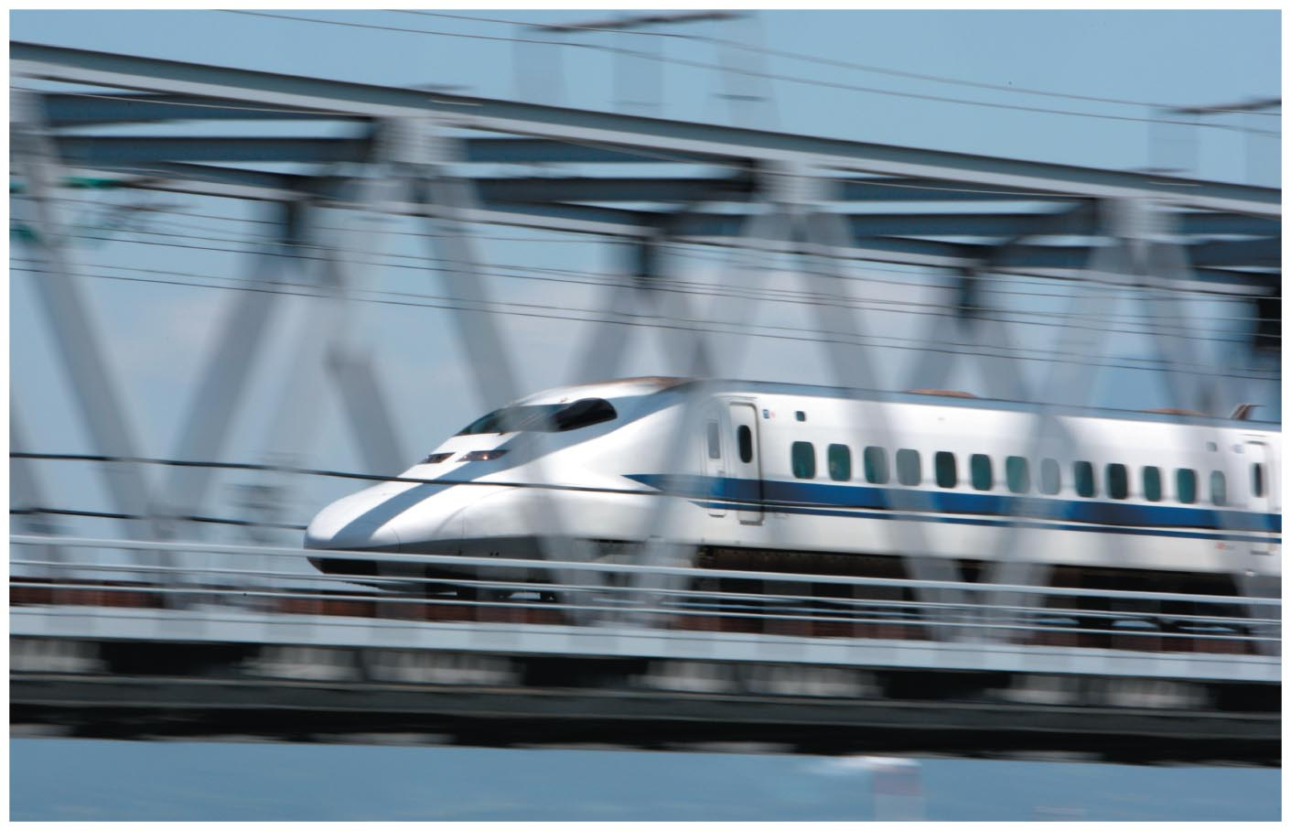
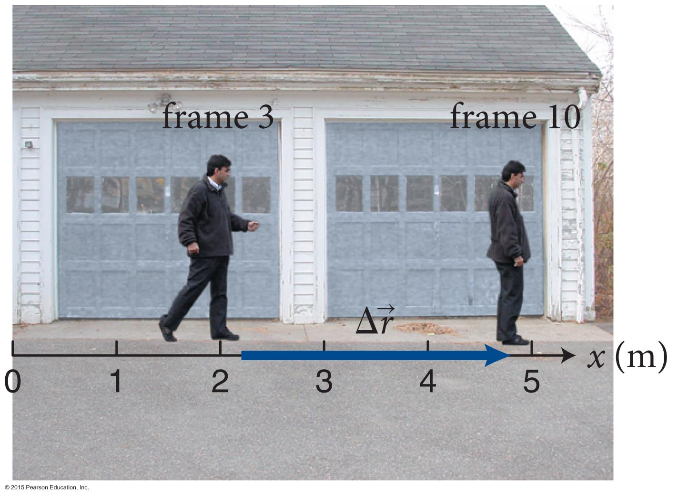
Chapter 2: Motion in One Dimension
LearningCatalytics: Module 1&2.
Perusall: p. 29, imaginary straight line; p. 31, Definition Displacement;
p. 32 “we shall always …”; p. 32 “In contrast to the …”; p. 34 - checkpoint 2.7; “steeper the slope …”; p. 35 “ An object’s average speed ..”; p. 35 “steeper the slope, higher the speed”; p. 35, average velocity definition. p. 36 “another striking feature – average velocity is negative …”, p.39 Scalars and vectors!; p. 40 unit vector;

Slide 3
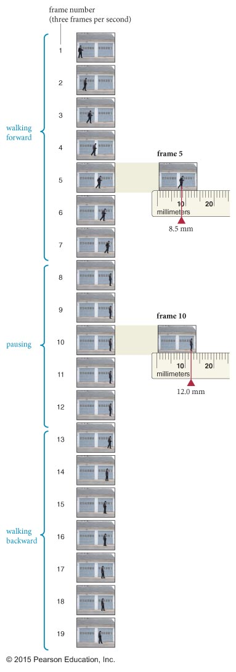
Section 2.1: From reality to model
To analyze the motion of an object, we need to keep track of the object’s position at different instants:
If the position does not change the object is at rest.
If the position changes the object is moving.

Slide 4
Section 2.1: From reality to model
Let us analyze the motion of a man walking by studying the film clip shown in the figure.
As a first step we need to establish
A reference axis—an imaginary straight line along the ground .
An origin—an arbitrarily chosen reference point: Choose the left edge of the frame in the figure.
Now using a ruler you can determine the position of the man in each frame measure from the origin.

Slide 5
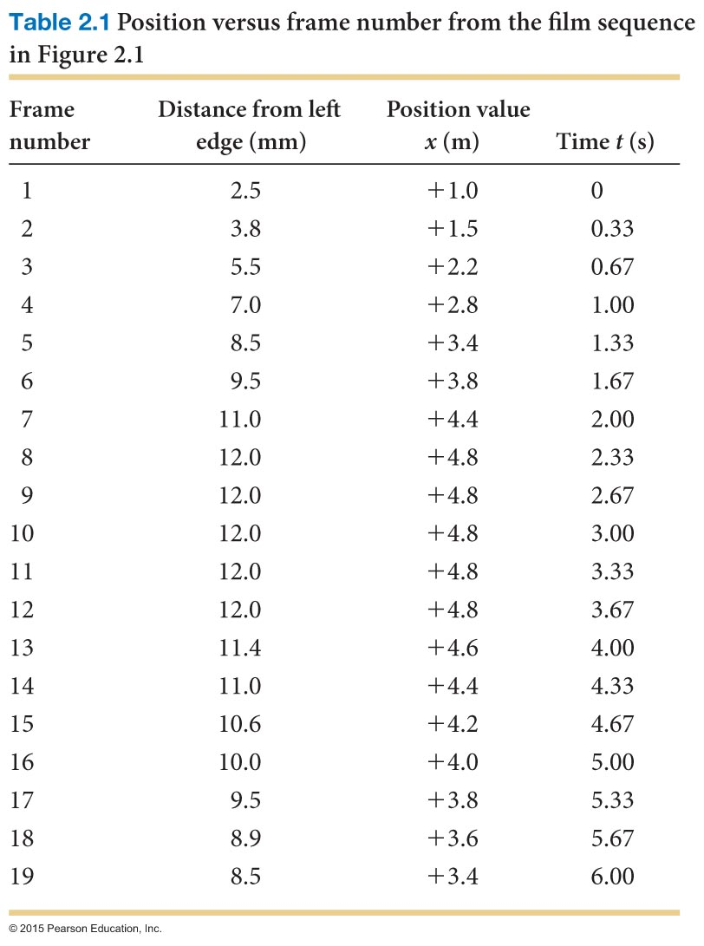
Section 2.1: From reality to model
Now we can describe the motion of the man by specifying his position for every frame as shown in the first 2 columns in Table 2.1

Slide 6
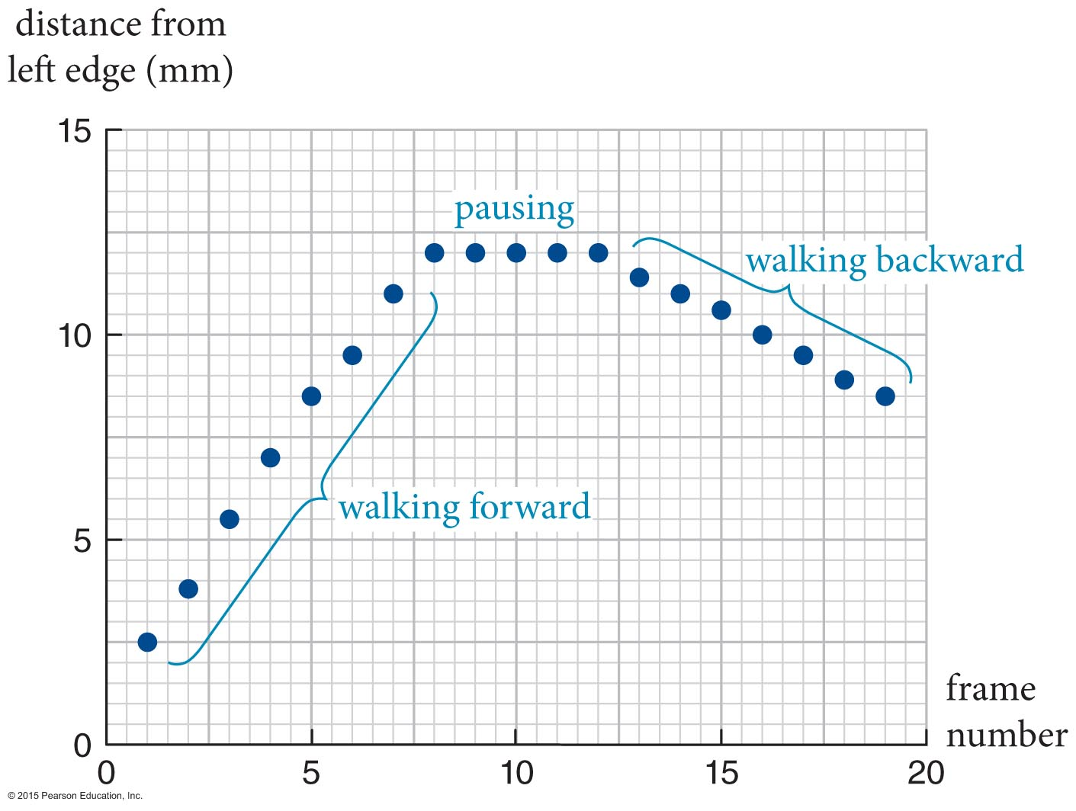
Section 2.1: From reality to model
The same information can be shown graphically:
The man’s position relative to the origin is plotted along the vertical axis.
The horizontal axis represents the frame numbers.

Slide 7
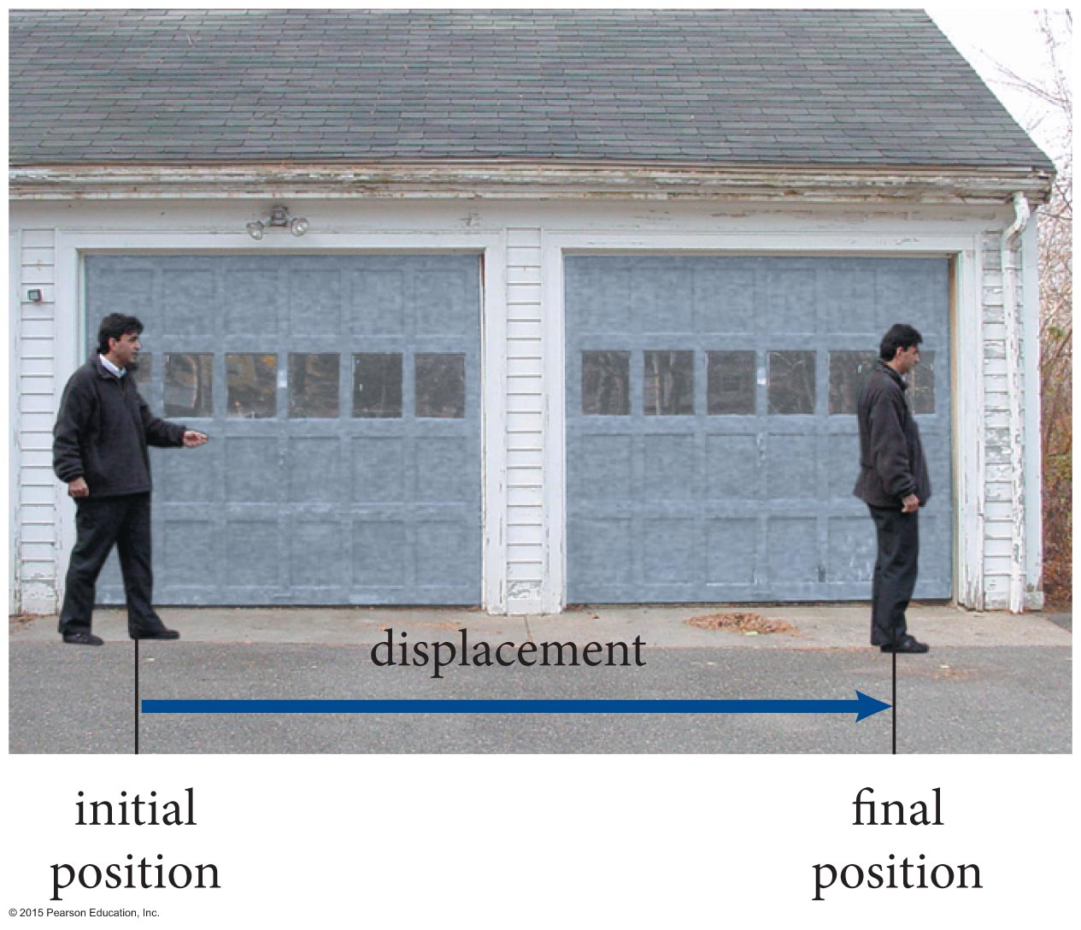
Displacement
Section 2.2: Position and displacement
The arrow pointing from the initial position of an object to its final position represents a physical quantity called the displacement of the object.
Displacement does not depend on the choice of reference axis or origin.

Slide 8
Section 2.2: Position and displacement
The x component of an object’s displacement is the change in its x coordinate.
The value of the x component of the displacement is obtained by subtracting the initial x coordinate from the final x coordinate and is independent of the choice of origin: Displacement = Final position – Initial position
The x component of displacement is measured along some specific x axis.
The x component of displacement can be negative or positive.

Slide 9
Distance
Section 2.2: Position and displacement
The distance traveled is the distance covered by a moving object along the path of its motion.
In contrast to the x component of displacement, distance traveled is always positive.

Slide 10
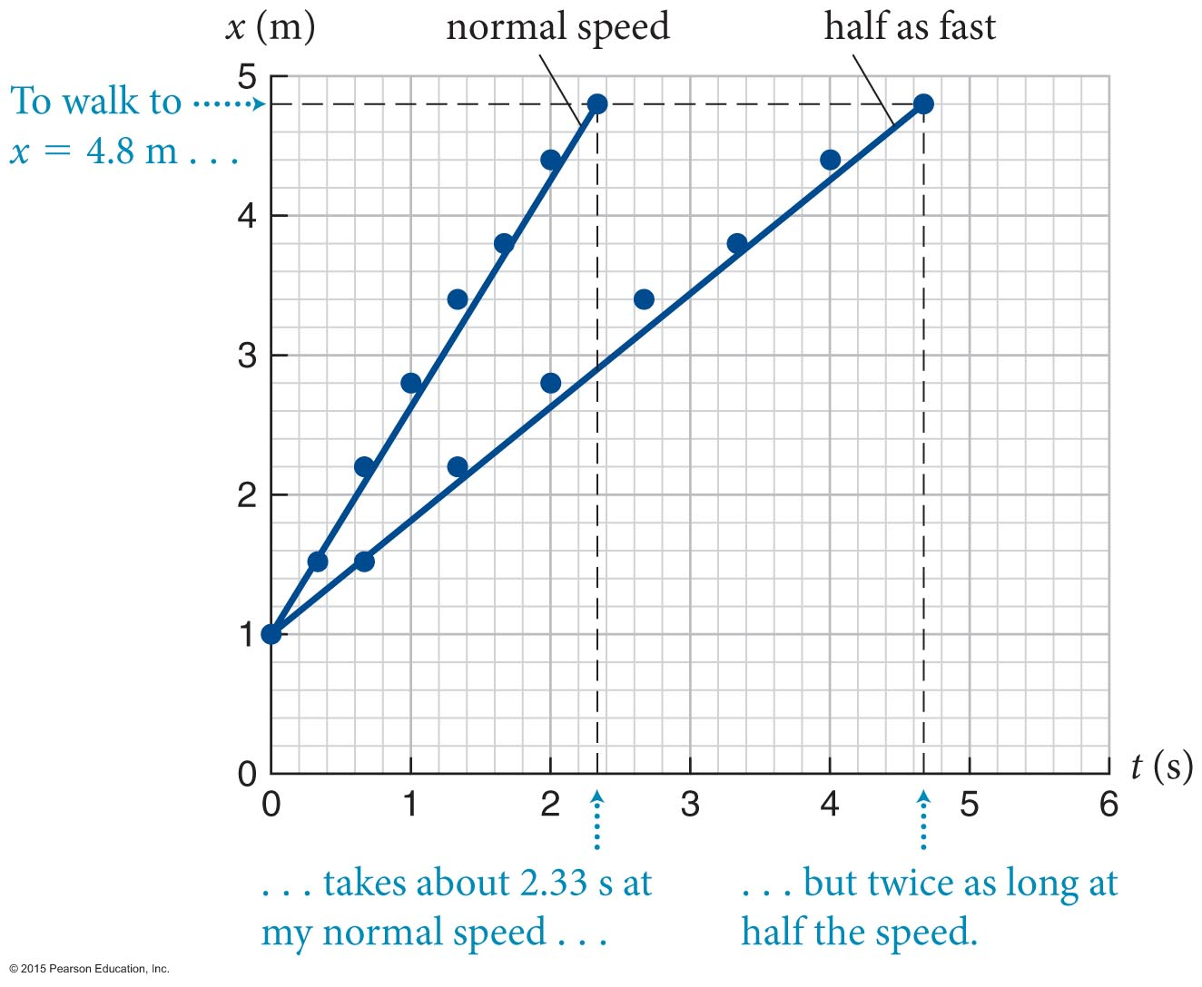
Average Speed
Section 2.4: Average speed and average velocity
An objects average speed is the distance traveled divided by the time interval required to travel that distance.
The rate at which the x-versus-t curve rises with increasing time is called the slope of the curve:
Notice how the slope becomes less steep when the speed decreases.

Slide 11
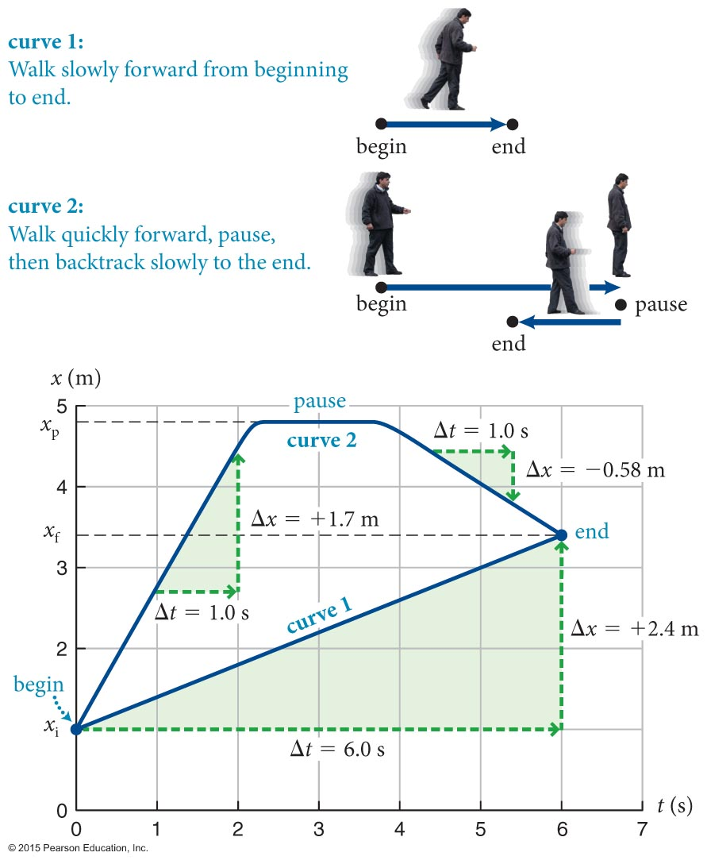
Section 2.4: Average speed and average velocity
Curve 1: Walk steadily from beginning to end. Speed =Distance (2.4m) divided by Time (6s). S = D/T = 2.4m / 6s = 0.4 m/s
Curve 2: Overshoot and return. Man travels a total distance of 3.8m + 1.4m = 5.2 m in 6.0 s: Average speed = (5.2 m)/(6.0 s) = 0.87 m/s.
Curve 3: speed?
1.4 m
end
3.8 m
2.4 m
begin
6 s

Slide 12
Velocity
Section 2.4: Average speed and average velocity
The quantity that gives both the speed and the direction of travel is velocity.
The x component of an object’s average velocity is the x component of its displacement divided by the length of the time interval taken to travel that displacement.

Slide 13
Chapter 2: Self-Quiz #2
One or more of the graphs in the figure represent an impossible motion. Identify which ones and explain why the motion is not possible.
two places at same time
two places at same time
kosher
intersection of lines indicates location of object at specific time

Slide 14
Section 2.5: Scalars and vectors
Scalars: Physical Quantities that are completely specified by a number, which can be positive or negative, and a unit of measure.
Examples: Temperature, volume
Scalars follow ordinary arithmetic laws (add, subtract, etc).
Vectors: Physical quantities that are completely specified by a magnitude and a direction in space.

Slide 15
Section 2.5: Scalars and vectors
In the next few chapters we will only study one-dimensional (1-D) motion.
An object can only move forward or backward in 1-D.
The direction in this case will be simply specified by an algebraic sign.
To distinguish vector quantities from scalars we will use the following notation:
vector
b scalar

Slide 16
Section 2.5: Scalars and vectors
distance?
direction?
Vectors transform under rotation; scalars do not

Slide 17
Section 2.5: Scalars and vectors
Is Price a scalar or vector? Does Price of Dallas transform under rotation of map? (no)
Is location of Dallas a scalar or vector?
Does location of Dallas transform under rotation of map? (yes)

Slide 18
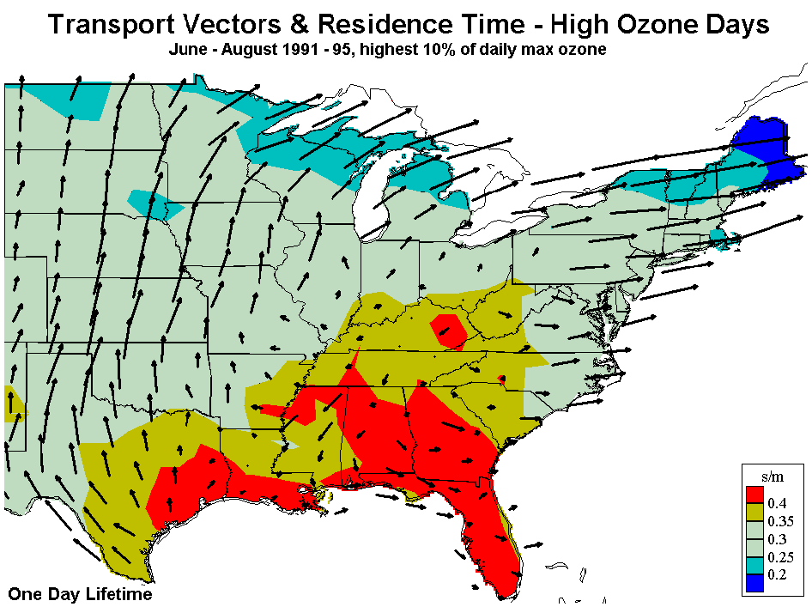
Section 2.5: Scalars and vectors
Is wind velocity a scalar or vector? Does wind velocity of Pennsylvania transform under rotation of map?
(yes)

Slide 19
Checkpoint 2.11
Are the following quantities vectors or scalars: (i) the price of a movie ticket, (ii) the average velocity of a ball launched vertically upward, (iii) the position of the corner of a rectangle, (iv) the length of a side of that rectangle?
2.11
length?

Slide 20
Section 2.5: Scalars and vectors
The magnitude of a vector tells us how much there is of that vector (or the size of the vector):
Magnitude is always positive.
The magnitude of vector is denoted by either or simply b.
To specify vectors mathematically we introduce unit vectors:
Unit vectors have a magnitude of 1.
Unit vectors are dimensionless.
A unit vector pointing in the positive x direction is denoted by .

Slide 21
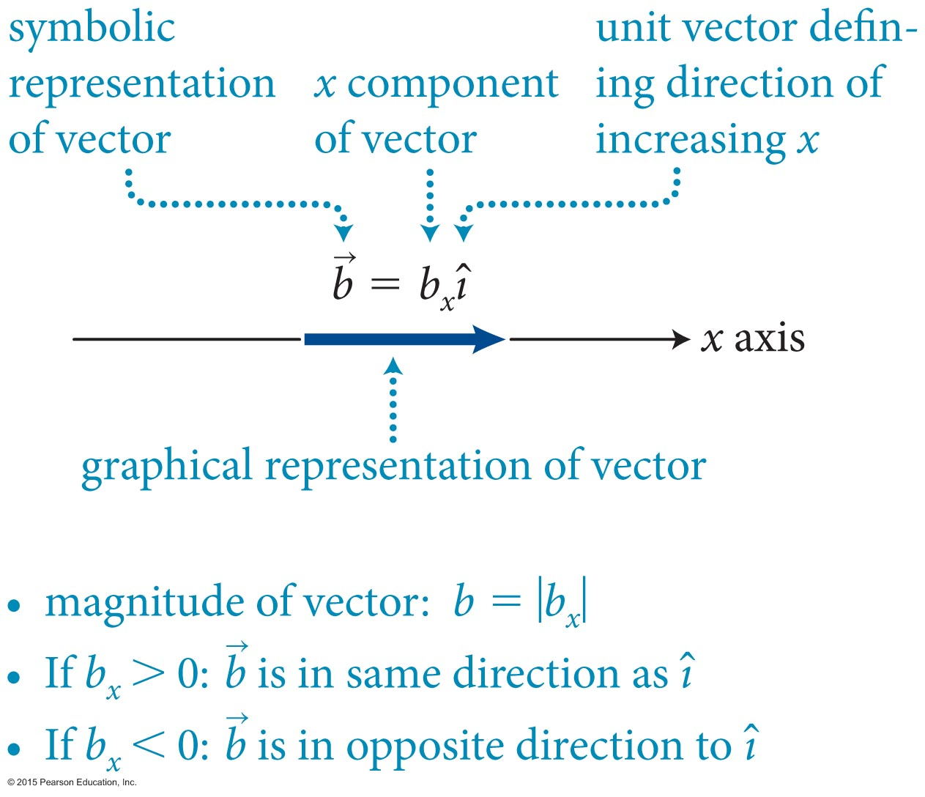
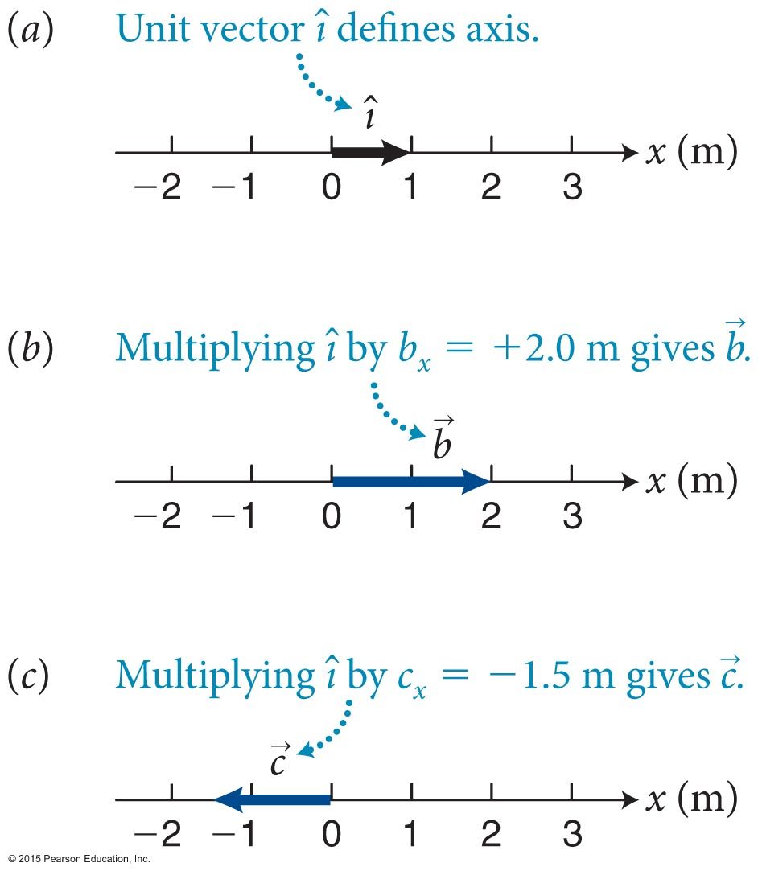
Section 2.5: Scalars and vectors
Any vector along the x axis can be written in unit vector notation.
Here, b_{x} is a scalar called the x component of the vector . b_{x} is negative if the vector points in the negative x direction.
For vectors in 1-D, the magnitude of the vector is equal to the absolute value of b_{x}.
is the direction
of

Slide 22
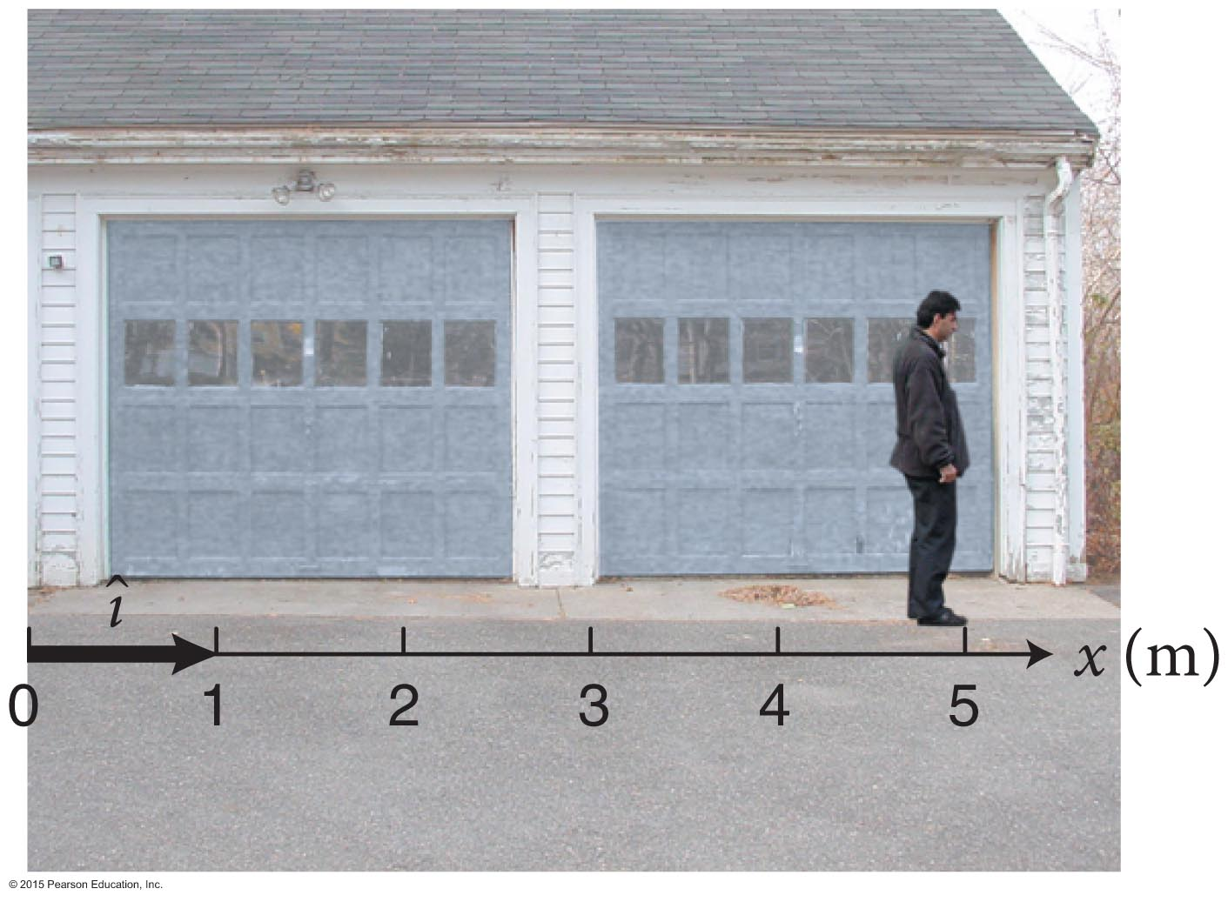
Checkpoint 2.12
Consider the axis and unit vector shown in Figure 2.18. Let the vector have its tail at the origin and its tip at my feet. (a) What is the x component of that vector? (b) Write the vector in terms of its x component and the unit vector. (c) What does the vector represent? (d) Does r_{x} = +2.5 m unambiguously determine a vector in Figure 2.18? If so, draw the vector, and state what it might represent.
2.12
(a)

Slide 23
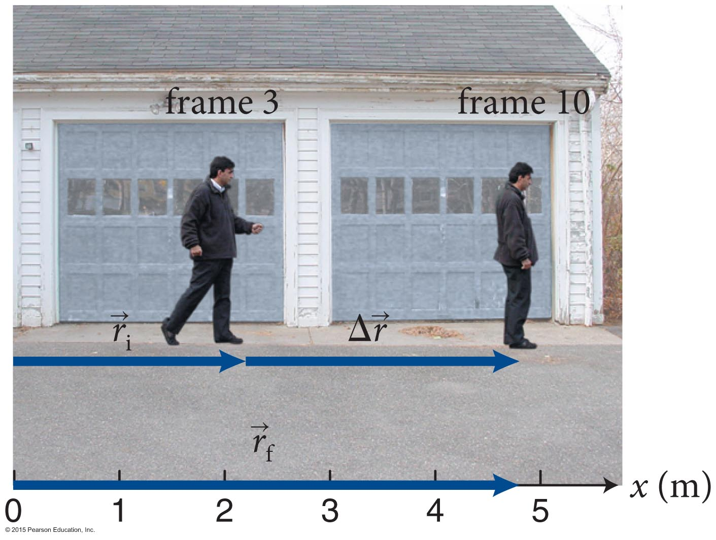
Section 2.6: Position and displacement vectors
Since displacement is a vector,
where
Using vector notation displacement can be written as
Rearranging Equation 2.10 we get the final position vector:

Slide 24
Section 2.7: Velocity as a vector
From the discussion in Section 2.4, the x component of average velocity is
Since average velocity can also be written using vector notation as

Slide 25
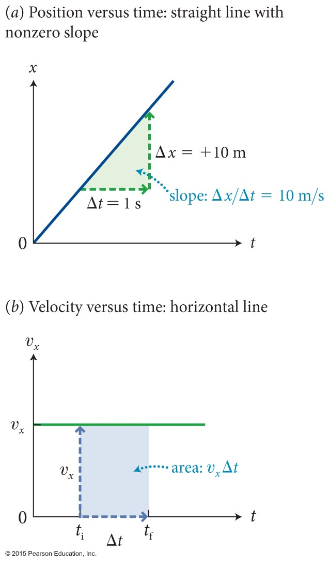
Section 2.8: Motion at constant velocity
If an object moves at a constant velocity, then the position-versus-time graph is a straight line. Because the slope of a straight line is a constant
υ_{x, av} = υ_{x}
So, we get
Δx = υ_{x} Δt (constant velocity)
Rearranging Equation 2.16 we get
x_{f} = x_{i} + υ_{x} Δt (constant velocity)
The x component of the displacement during any time interval is given by the area under the υ_{x}(t) curve between the beginning and the end of the time interval.

Slide 26
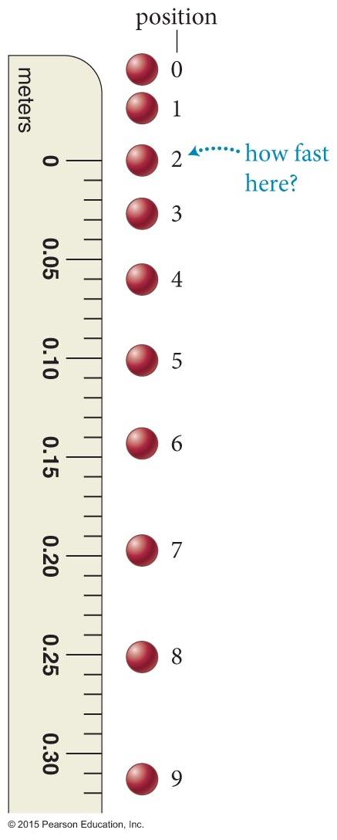
Section 2.9: Instantaneous velocity
The figure shows the successive position of a ball falling at 0.0300-s intervals.
We want to be able to find the velocity as the ball passes any position in its motion, that is the instantaneous velocity
Let us start by first finding the average velocity between positions 2 and 9:
position

Slide 27
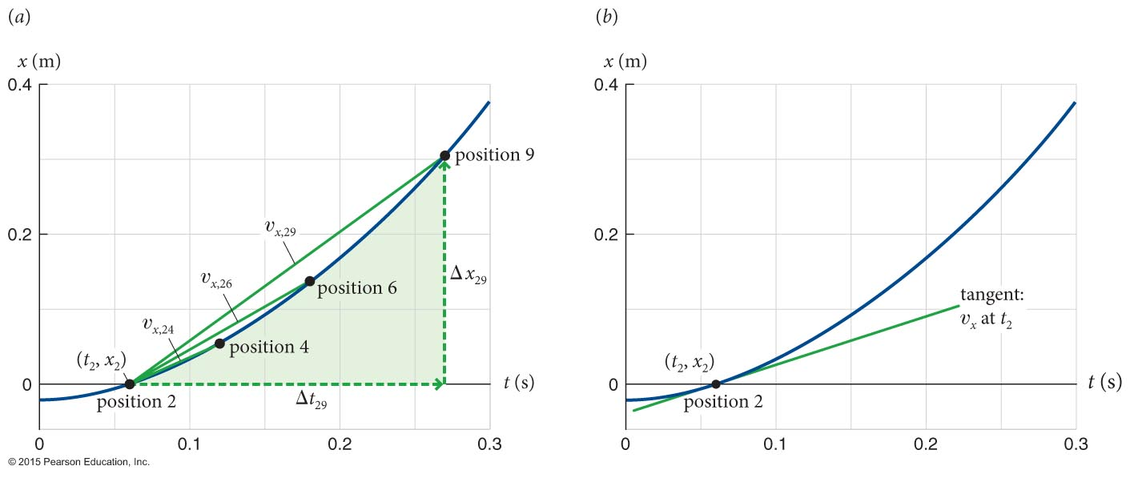
Section 2.9: Instantaneous velocity
By reducing the time interval Δt you can get closer to the velocity at point 2.
Letting Δt approach zero, we obtain the x component of the velocity at instant t:
The right side of the equation is the definition for the derivative, so

Slide 28
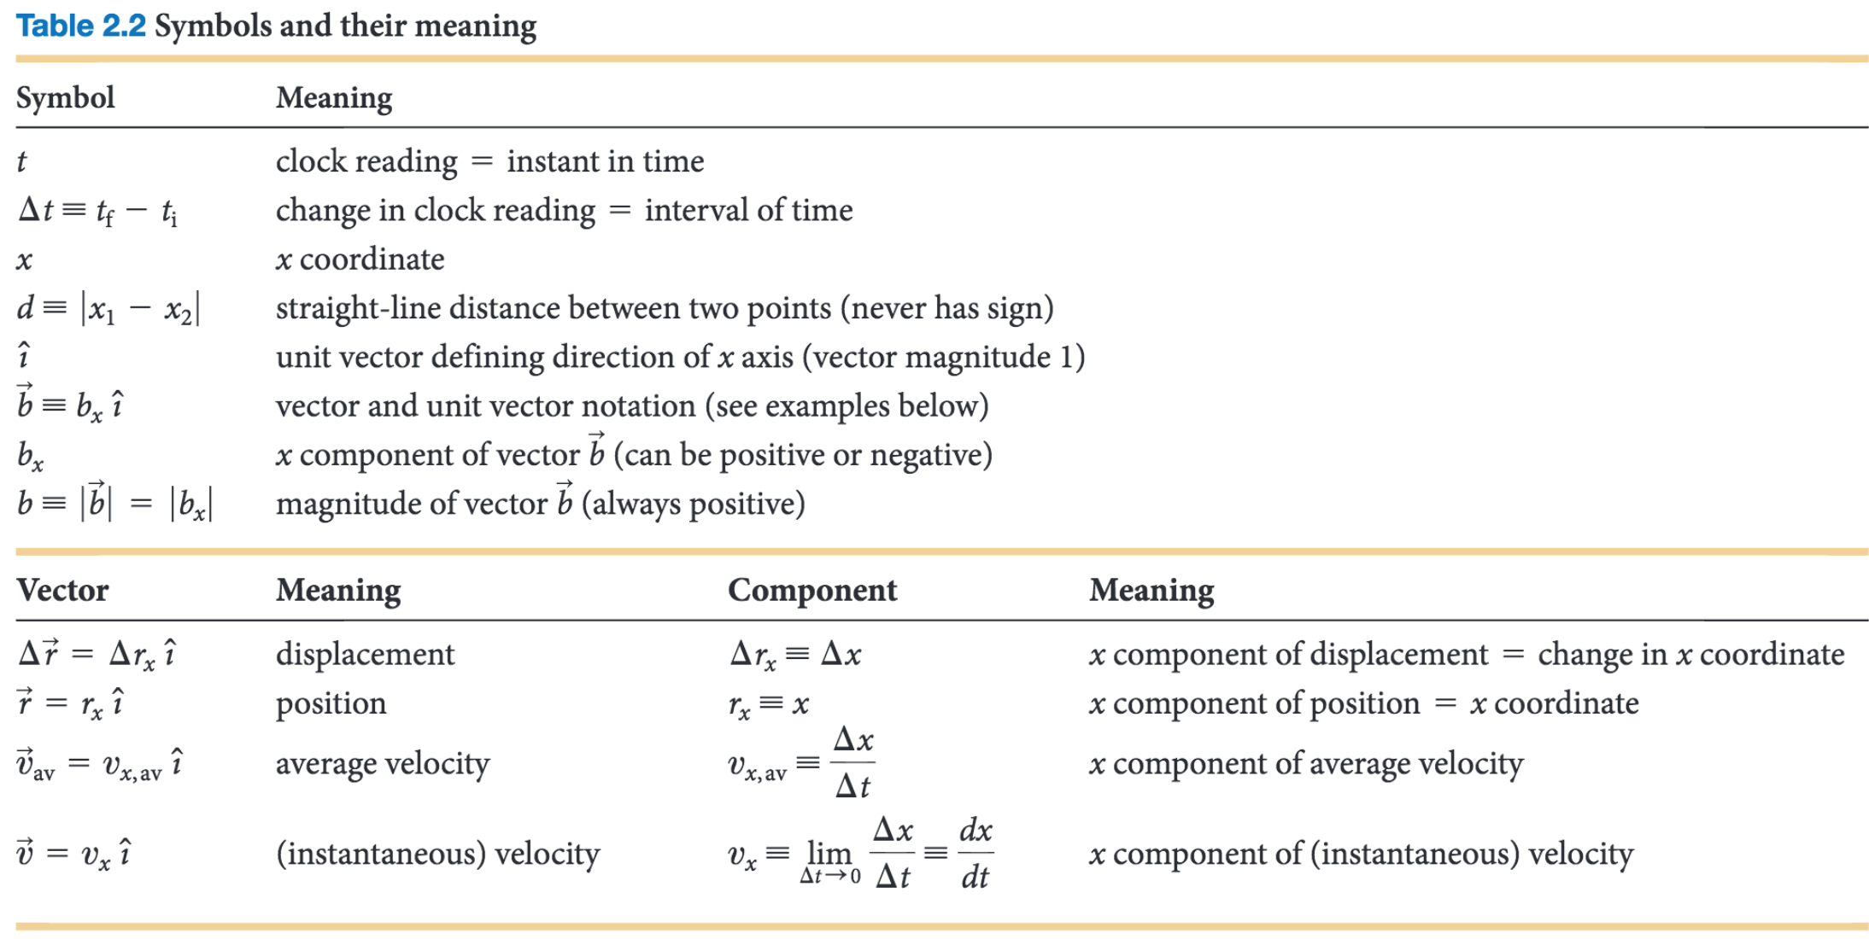
Chapter 2: Summary

